Slide 1

Note: The data and infrmation in this document is reflective of a hypothetical situation and client. This document is to be used for KPMG Virtual Internship purposes only.
Sprocket Central Pty Ltd
Data analytics approach
Nikhil Zodape
Date: 10/05/2023

Slide 2
Note: The data and information in this document is reflective of a hypothetical situation and client. This document is to be used for KPMG Virtual Internship purposes only.
Agenda
Introduction
Data Exploration
Model Development
Interpretation

Slide 3
Note: The data and information in this document is reflective of a hypothetical situation and client. This document is to be used for KPMG Virtual Internship purposes only.
Introduction
Identify and Recommend Top 1000 Customers to Target from Datasets
Outline of Problem:
Sprocker central is a company that specializes in high-quality bikes and accessories.
Their marketing team is looking to boost business sales.
Using the 3 dataset that are provided the aim is to analyse and recommend 1000 customers that Spocket Central should target to drive higher value for the company.
Approach for Data Analysis:
New and old Customers Age Distribution
Bike related purchased over the 3 years by gender.
Wealth Segment by age category.
Numbers of cars owned by states.
Job industry distribution
Profit by brand and product line.

Slide 4
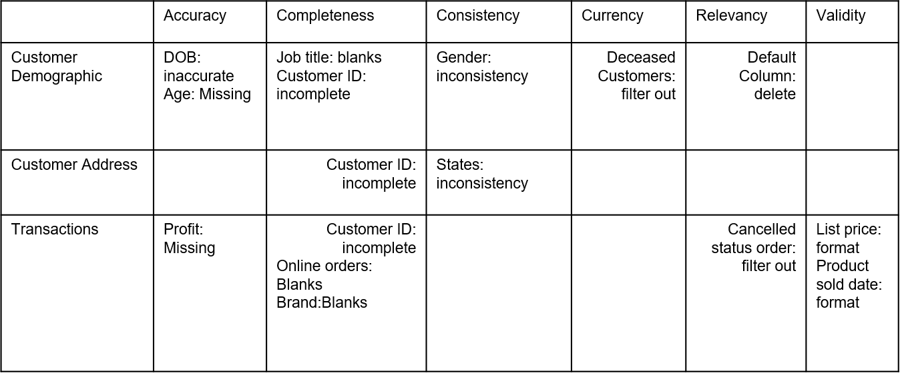
Note: The data and information in this document is reflective of a hypothetical situation and client. This document is to be used for KPMG Virtual Internship purposes only.
Data Exploration
Data Quality Assessment and Clean Up
SUMMARY TABLE
Key issue dealt with for the data quality issue:
Accuracy – Correct Values
Completeness – Data field with Values
Consistency – Values free from Contradiction
Currency – Value up to date
Relevancy - Data items with Value Meta-data
Validity – Data Containing Allowable Values
Uniqueness - Records that are Duplicated

Slide 5
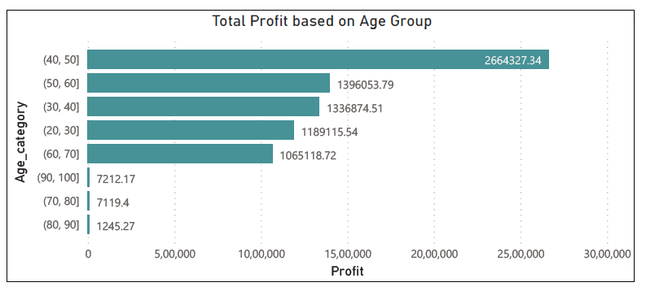
Note: The data and information in this document is reflective of a hypothetical situation and client. This document is to be used for KPMG Virtual Internship purposes only.
Data Exploration
Total Profit based on different Age Groups
The customers between 40 to 50 age are the most profitable in terms of recent transaction history with more than 26+ lacs profit.

Slide 6
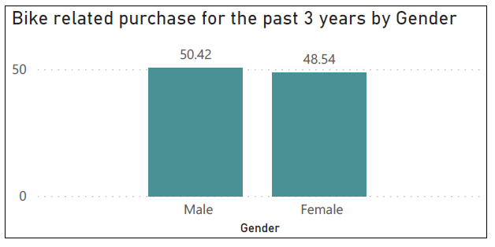
Note: The data and information in this document is reflective of a hypothetical situation and client. This document is to be used for KPMG Virtual Internship purposes only.
Data Exploration
Bike Related Purchase Over The Last 3 Years Based On Gender
Data shows, on an average the males have made more bike related purchased compared to the female.
On an average Male have 2% higher bike related purchase compare to the female in the last 3 years.

Slide 7
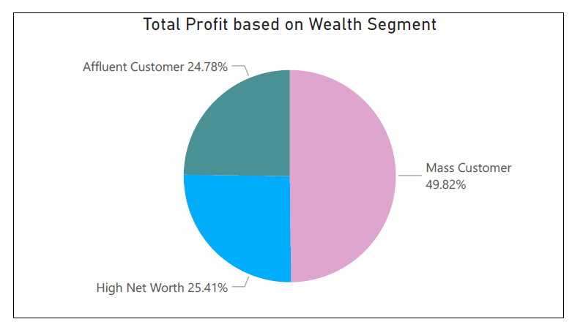
Note: The data and information in this document is reflective of a hypothetical situation and client. This document is to be used for KPMG Virtual Internship purposes only.
Data Exploration
Total Profit based on Wealth Segment
The mass customers are the more profitable segment among the three segment as nearly 50% of the profit is made by this segment.

Slide 8
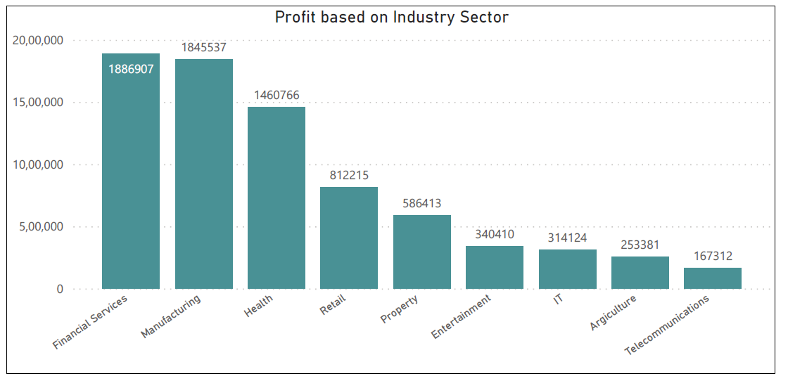
Note: The data and information in this document is reflective of a hypothetical situation and client. This document is to be used for KPMG Virtual Internship purposes only.
Data Exploration
Profit based on Industry Sector
The financial Services and the Manufacturing Sectors are the most profitable sectors among the Industry sectors followed by Health and Retail.

Slide 9
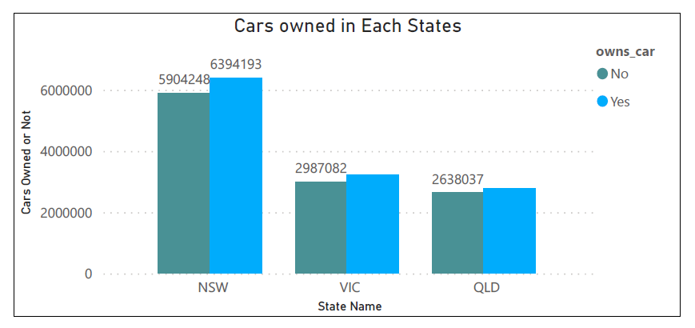
Note: The data and information in this document is reflective of a hypothetical situation and client. This document is to be used for KPMG Virtual Internship purposes only.
Data Exploration
Numbers of cars owned and not owned by states
NSW has the largest amount that do not own a car. NSW seems to have a higher numbers of people from which data was collected.
VIC and QLD is also split quite evenly. But both numbers are significantly lower that those of NSW.

Slide 10
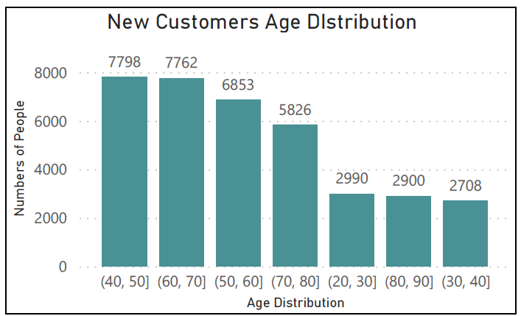
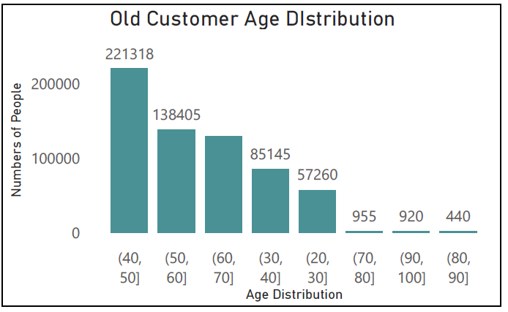
Note: The data and information in this document is reflective of a hypothetical situation and client. This document is to be used for KPMG Virtual Internship purposes only.
Data Exploration
New and Old Customers Age Distributions
Most customers are age between 40-50 in New. In Old majority of customers are age between 40-50 also.
The lowest age group are 20-30 and 70+ for both New and Old customers list.
There is a steep drop of customers after the 60-70 age group in New and Old.

Slide 11
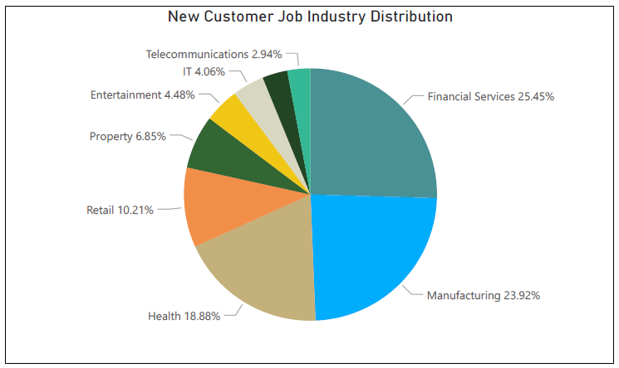
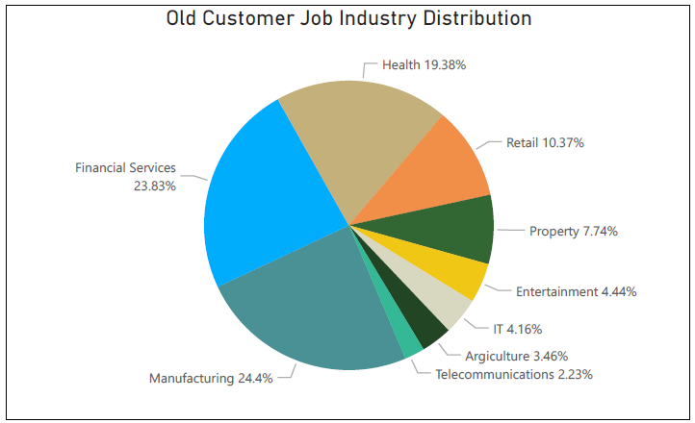
Note: The data and information in this document is reflective of a hypothetical situation and client. This document is to be used for KPMG Virtual Internship purposes only.
Data Exploration
Job Industry Distribution
Almost 25% of New customers are in Financial Services and 24% of New customers are in Manufacturing.
The smallest numbers of customers are in Telecommunications in New as well as Old Customers.
Also the similar pattern in Old customers of 24% Manufacturing and almost 24% of Financial services respectively.

Slide 12
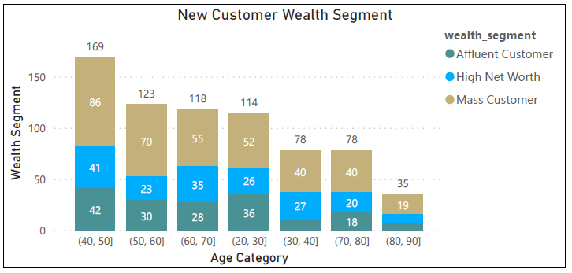
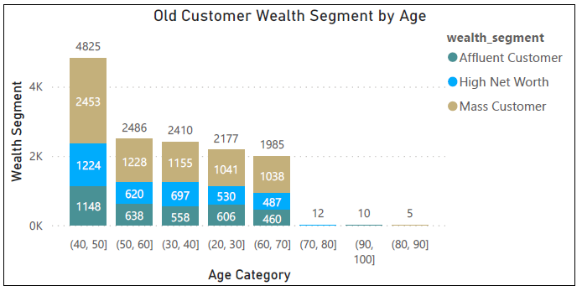
Note: The data and information in this document is reflective of a hypothetical situation and client. This document is to be used for KPMG Virtual Internship purposes only.
Data Exploration
Wealth Segmentation by Age Category
In all the age category the largest number of customers are classified as Mass Customers.
The next category is the High Net Worth.
The Affluent Customer can outperforms the High Net Wroth customers in the range of 50-60 Age group.

Slide 13
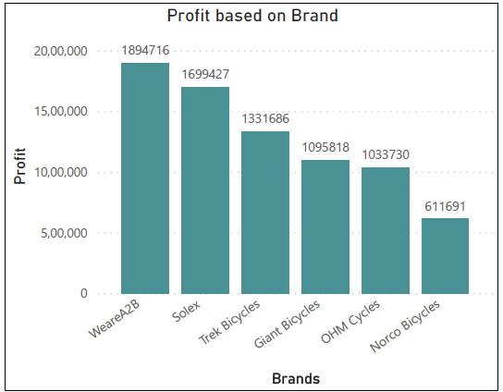
Note: The data and information in this document is reflective of a hypothetical situation and client. This document is to be used for KPMG Virtual Internship purposes only.
Data Exploration
Total Profit by Brand
WeareA2B and Solex are the top 2 profitable brand among all.
So we can say that as they both have higher profit the sells of those two brands are more than other brand.

Slide 14
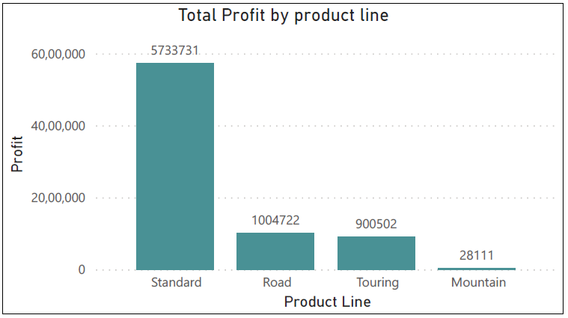
Note: The data and information in this document is reflective of a hypothetical situation and client. This document is to be used for KPMG Virtual Internship purposes only.
Data Exploration
Total Profit by Product line.
Standard product are most buyable product by the customers among the other product with more than 57,00,000+ profit is given to the company.

Slide 15
Note: The data and information in this document is reflective of a hypothetical situation and client. This document is to be used for KPMG Virtual Internship purposes only.
Model Development
CUSTOMER CLASSIFICATION – Targeting High Value Customers
The following are the high-value clients to target from the new list :
Aged between 50 – 59.
Most of the high value customers are male compared to female
Working in Financial Service, Manufacturing and Health.
Who are currently living in New South Wales and Victoria.

Slide 16
Note: The data and information in this document is reflective of a hypothetical situation and client. This document is to be used for KPMG Virtual Internship purposes only.
Model Development
Customer Title Definition list with RFM values assigned
Rank | Customer Title | Description | RFM Values
1 | Platinum Customer | Most Recent buy, buys often, most spent | 444
2 | Very Loyal | Most recent, buys often, spend large amount of money | 442
3 | Becoming Loyal | Relatively recent, bought more than once, spends large amount of money | 421
4 | Recent Customer | Bought recently, not very often, average money spent | 344
5 | Potential Customer | Bought recently, never bought before, spent small amount | 323
6 | Late Bloomer | No purchase recently, but RFM value is larger than average | 311
7 | Loosing Customer | Purchase was a while ago, below average RFM value. | 224
8 | High Risk Customer | Purchase was a long time ago, frequency is quite high, amount spent is high | 212
9 | Almost Lost Customer | Very low recency, low frequency but high amount spent | 124
10 | Evasive Customer | Very low recency, Very low frequency, small amount spent | 112
11 | Lost Customer | Very low RFM | 111

Slide 17
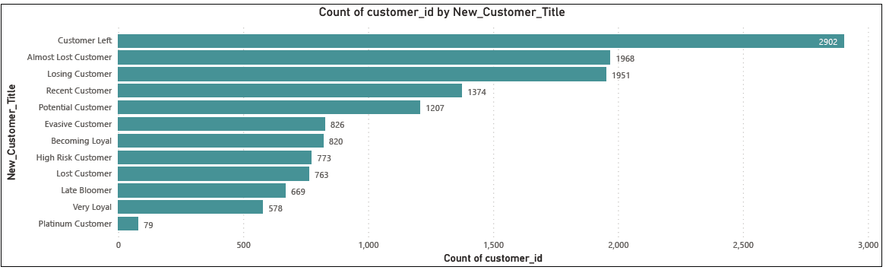
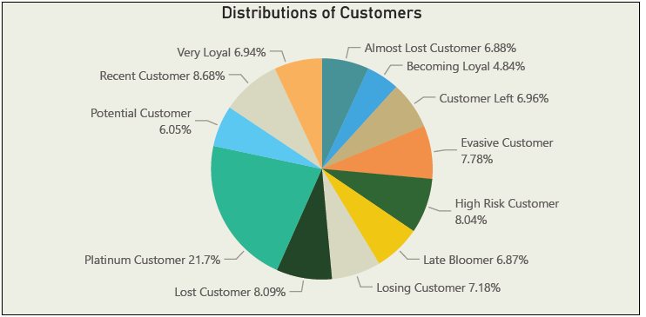
Note: The data and information in this document is reflective of a hypothetical situation and client. This document is to be used for KPMG Virtual Internship purposes only.
Model Development
Customer Title Distribution in Datasets

Slide 18
Note: The data and information in this document is reflective of a hypothetical situation and client. This document is to be used for KPMG Virtual Internship purposes only.
Interpretation
HIGH-VALUE CUSTOMER SUMMARY TABLE
Customer ID | Bike Related Purchases for the last 3 years | Age | Job Industry | Wealth Segment | Owns Cars | State
1842 | 445 | 44 | Financial Services | Mass Customer | No | New South Wales
2001 | 168 | 44 | Manufacturing | Mass Customer | Yes | New South Wales
650 | 486 | 44 | Health | Mass Customer | No | New South Wales
3297 | 234 | 46 | Manufacturing | Mass Customer | No | Victoria
50 | 266 | 41 | Manufacturing | Mass Customer | Yes | New South Wales

Slide 19
Note: The data and information in this document is reflective of a hypothetical situation and client. This document is to be used for KPMG Virtual Internship purposes only.
Thank You

